Slide 1
Water quality monitoring for
Legionella pneumophila and E. Coli

Slide 2
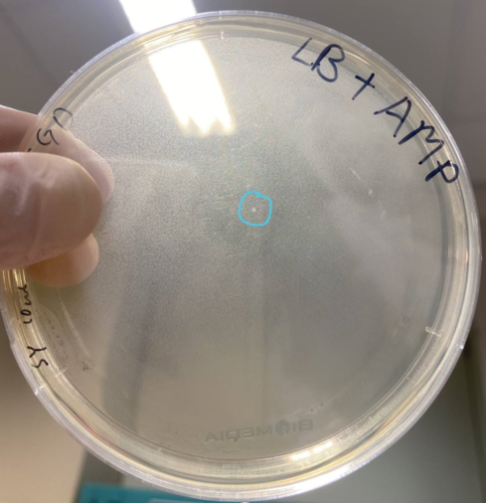
Approach to water sample extraction of bacterial cell (E. coli)
    End goal
    Develop a simple and rapid workflow for water sample processing
    Develop a quicker and sensitive method (filtration > extraction > detection)
Plans (Suggested)
Pick 1 colony and resuspend in 1mL media
Take out 10 µL out of 1 mL and grow on plate at 37degC
Recalculate back the original
The remaining 1mL will be stored at 4degC for future spike in purposes.
Notes:
https://www.bio-rad.com/en-sg/sku/3578121-aquadien-bacterial-dna-extraction-purification-kit?ID=3578121
https://www.qiagen.com/us/products/discovery-and-translational-research/dna-rna-purification/dna-purification/microbial-dna/dneasy-powerwater-kit/
https://www.thermofisher.com/order/catalog/product/D211001

Slide 3
Approach to water sample extraction of bacterial cell
    End goal
    Develop a simple and rapid workflow for water sample processing
    Develop a quicker and sensitive method (filtration > extraction > detection)
Plans
Determine the limit of extraction and detection of gDNA with e coli (high to low counts)
(100µL of E1) Lowest E. coli counts that could be detected post extraction
Sample with conc. falls within quantifiable range
Too high to detect
Detection
Qubit
Nanodrop
S2
Dilute and culture on agar plate, and recalculate back E1 bacterial counts in 100 µL)
X
Quantifiable
X
X
Too low to detect
X
Limit of Extraction & Detection (Qubit/ nanodrop)
X
S1
* qPCR detection for further diluted counts
Qubit detection
2. Comparison of different extraction method
  Grow substantial amount of E. coli (that could be detected if extracted), and compare
  1. Direct extraction from direct sample (Extraction > Detection) 2. After spike into 5mL water (Filtration > extraction > detection)
To determine
yield loss (%)
Notes:
https://www.bio-rad.com/en-sg/sku/3578121-aquadien-bacterial-dna-extraction-purification-kit?ID=3578121
https://www.qiagen.com/us/products/discovery-and-translational-research/dna-rna-purification/dna-purification/microbial-dna/dneasy-powerwater-kit/
https://www.thermofisher.com/order/catalog/product/D211001

Slide 4
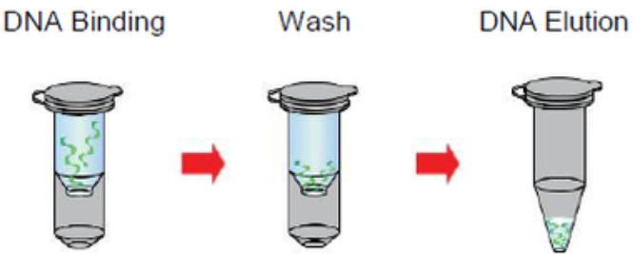
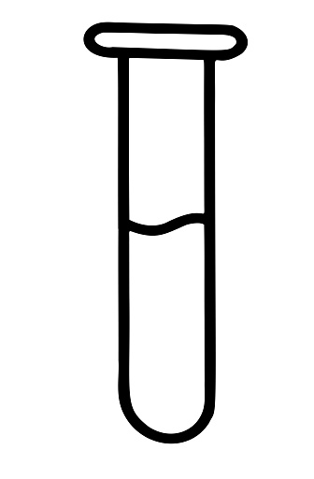
Comparison of Extraction protocol overview
Bacterial Culture
Pick colony (s) into 3mL LB
Grow at 37degC, 200 rpm for ~16 hr
Volume aliquote for extraction
Bacterial gDNA Extraction: QIAamp DNA mini kit (column)
QIAamp DNA mini kit consumables
Treatment 1 Reagent 1+Proteinase K
Treatment 2 Reagent 2
Add Ethanol
1
56degC for 1-3 hr.
2
70degC for 10 mins.
3
Est. ~20-30 mins.
*2 heating temperature for =< 75mins
To have substantial amount of e. coli for testing.
Treatment 1
Lysis buffer 1
QIAamp DNA mini kit consumables
gDNA Quantification
Nanodrop
Qubit
1
80degC for 10 mins.
Bacterial gDNA Extraction: Prepared Lysis Buffer + column
Est. ~20-30 mins.
* 1 heating temperature for 10 mins
E Lysis buffer:
NaOH
Ethanol
EDTA
Notes:
https://www.bio-rad.com/en-sg/sku/3578121-aquadien-bacterial-dna-extraction-purification-kit?ID=3578121
https://www.qiagen.com/us/products/discovery-and-translational-research/dna-rna-purification/dna-purification/microbial-dna/dneasy-powerwater-kit/
https://www.thermofisher.com/order/catalog/product/D211001

Slide 5
Comparison of Extraction protocol: Nanodrop & Qubit
# | Sample ID | Nanodrop Nucleic Acid (ng/µL) | 260/280 | 260/230 | Sample Type | Qubit concentration (ng/µL) | Volume eluted (µL)
 | Ext. E.Coli Plate | 0.9 | 2.52 | 16.07 | DNA | Too Low To Detect | 200
 | 220422ECQamp 1000 µL | 13.8 | 2.19 | 2.34 | DNA | 7.7 | 200
1 | 220422ECQamp 100 µL | 4.8 | 2.26 | 2.51 | DNA | 0.414 | 80
2 | 220422ECQamp 10 µL | 1.2 | 2.15 | -7.03 | DNA | 0.24 | 80
3 | 220422ECQamp 1 µL | 0.9 | -9.94 | 1.29 | DNA | Too Low To Detect | 80
4 | 220422ECQamp 0.1 µL | 1 | 14.33 | -13.6 | DNA | Too Low To Detect | 80
5 | 220422ECQamp 0.01 µL | 0.9 | 7.7 | 1.71 | DNA | Too Low To Detect | 80
6 | 220422ECQamp 0.001 µL | 0.6 | -2.77 | -0.24 | DNA | Too Low To Detect | 80
7 | 220422ECQamp 0.0001 µL | 0.5 | -0.92 | 0.89 | DNA | Too Low To Detect | 80
1 | 220422EC 100 µL | 4.6 | 2.15 | -2.31 | DNA | 0.218 | 80
2 | 220422EC 10 µL | 1.5 | 3.25 | -0.32 | DNA | Too Low To Detect | 80
3 | 220422EC 1 µL | 1.4 | 2.18 | -0.38 | DNA | Too Low To Detect | 80
4 | 220422EC 0.1 µL | 0.8 | -1.11 | -0.18 | DNA | Too Low To Detect | 80
5 | 220422EC 0.01 µL | 1.1 | 18.37 | -0.31 | DNA | Too Low To Detect | 80
6 | 220422EC 0.001 µL | 1.4 | 5.98 | -0.4 | DNA | Too Low To Detect | 80
7 | 220422EC 0.0001 µL | 1.4 | 5.77 | -0.35 | DNA | Too Low To Detect | 80
Bacterial gDNA Extraction: QIAamp DNA mini kit (column)
Will be tested for Developed qPCR
Bacterial gDNA Extraction: Prepared Lysis Buffer + column
Nanodrop & Qubit were unable to detect extracted samples below 10 µL.
The extracted samples were tested with qPCR subsequently with the primers we have just received
Notes:
https://www.bio-rad.com/en-sg/sku/3578121-aquadien-bacterial-dna-extraction-purification-kit?ID=3578121
https://www.qiagen.com/us/products/discovery-and-translational-research/dna-rna-purification/dna-purification/microbial-dna/dneasy-powerwater-kit/
https://www.thermofisher.com/order/catalog/product/D211001

Slide 6
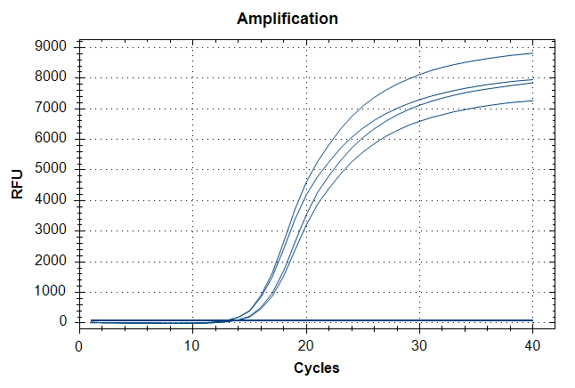
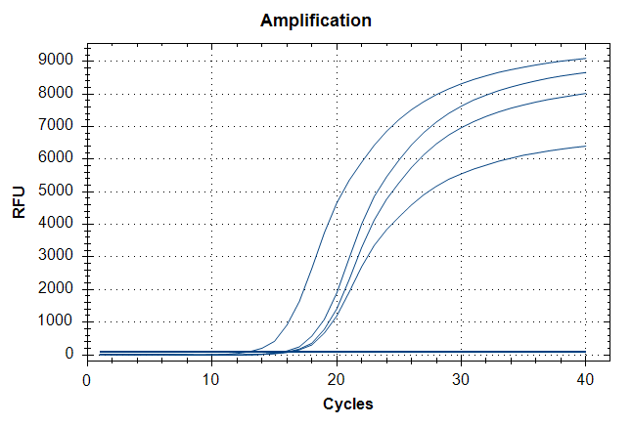
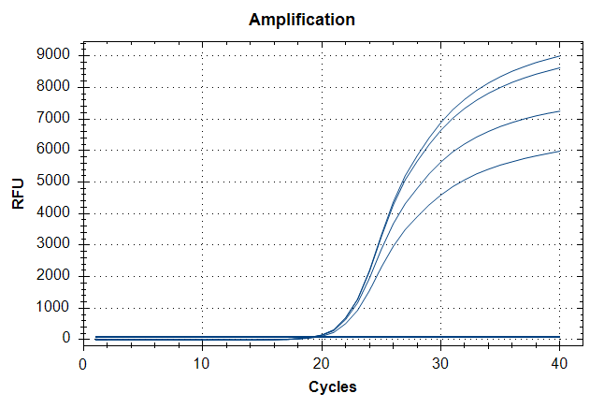



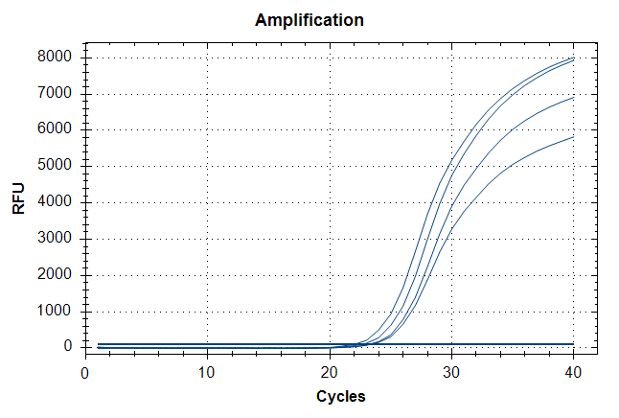
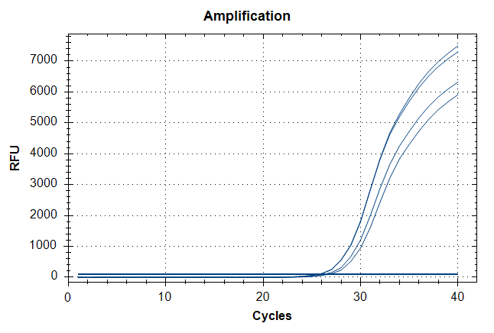
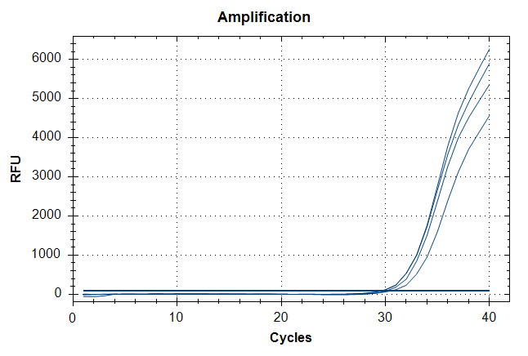



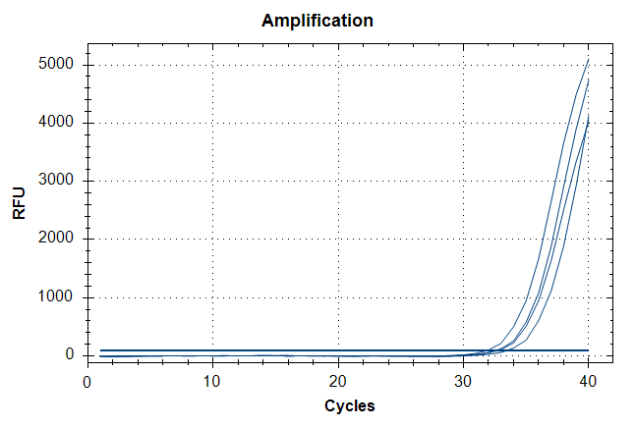

Comparison of Extraction protocol: qPCR detection of UidA (E. coli)
Highest titer
EC 100 µL
EC 10 µL
EC 1 µL
E Lysis buffer
QIAamp
QIAamp
E Lysis buffer
E Lysis buffer
QIAamp
EC 0.1 µL
EC 0.01 µL
EC 0.001 µL
E Lysis buffer
E Lysis buffer
E Lysis buffer
QIAamp
QIAamp
QIAamp
EC 0.0001 µL
E Lysis buffer
Note:
qPCR detection demonstrated that the extraction efficiency of E lysis protocol with reference protocol (QIAamp DNA mini kit) were comparable with ~1 ct difference.
QIAamp
Lowest titer
Notes:
https://www.bio-rad.com/en-sg/sku/3578121-aquadien-bacterial-dna-extraction-purification-kit?ID=3578121
https://www.qiagen.com/us/products/discovery-and-translational-research/dna-rna-purification/dna-purification/microbial-dna/dneasy-powerwater-kit/
https://www.thermofisher.com/order/catalog/product/D211001

Slide 7
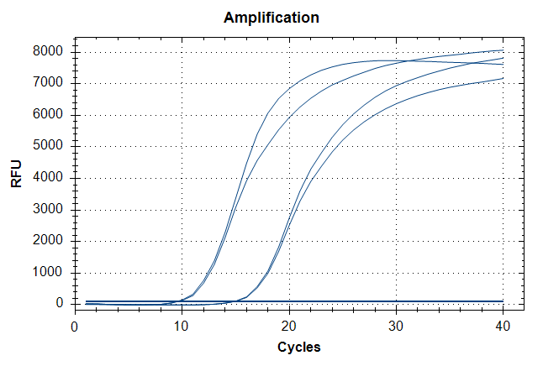
Advantages of Prepared buffer protocol:
1. Flexible in modification of lysis buffer for optimization
2. Shorter duration of extraction from bacterial cells (10 mins instead of 75 mins)
3. 100 µL of sample (No need to centrifuge for pellet) can be processed directly.
4. Currently, 1 heating temperature (80 degC) as compared to reference protocol (56 & 70 degC).
Disadvantages of Prepared buffer protocol:
1. May be inefficient in extracting cell pellet with E Lysis buffer; ~50% (nanodrop)
qPCR difference
QIAamp
E Lysis
buffer
EC pellet
Subsequent Plans:
Optimization of Prepared Lysis buffer
1. Temperature: RT vs 70degC (10mins) vs 80 degC (10mins) vs 90 degC (10mins)
2. Modification (Addition of detergent etc.)
Direct Sample extraction vs Filtered Sample Extraction;
1. Syringe membrane filter (0.2um) may be used to trap Bacterial cells (I.e. E. coli) from water sample (Spiked-in samples).
2. Lysis of cells within the membrane filter using modified buffer.
3. Determine % of yield loss.
Notes:
https://www.bio-rad.com/en-sg/sku/3578121-aquadien-bacterial-dna-extraction-purification-kit?ID=3578121
https://www.qiagen.com/us/products/discovery-and-translational-research/dna-rna-purification/dna-purification/microbial-dna/dneasy-powerwater-kit/
https://www.thermofisher.com/order/catalog/product/D211001

Slide 8
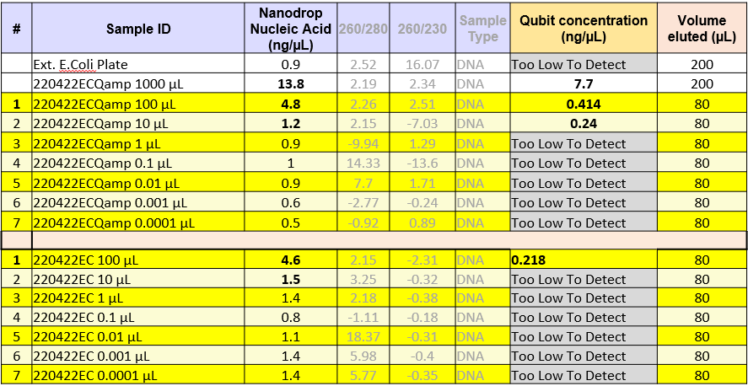
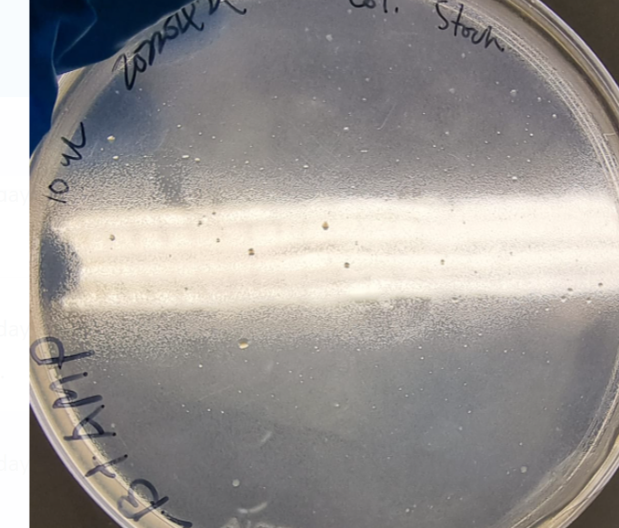
Quantification: and cell count
Notes:
https://www.bio-rad.com/en-sg/sku/3578121-aquadien-bacterial-dna-extraction-purification-kit?ID=3578121
https://www.qiagen.com/us/products/discovery-and-translational-research/dna-rna-purification/dna-purification/microbial-dna/dneasy-powerwater-kit/
https://www.thermofisher.com/order/catalog/product/D211001

Slide 9
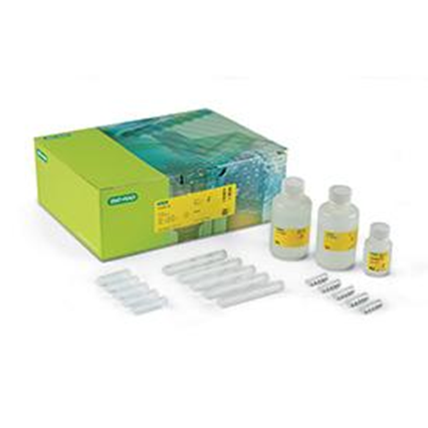
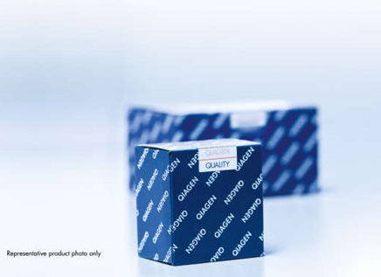
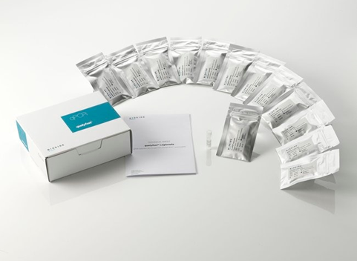
Commercially Available Extraction Kits for Nucleic Acid Extraction
Bio Rad - Aquadien™ Bacterial DNA Extraction and Purification Kit
Applicable for both Legionella
& E. coli Extraction
Suitable for: Bacterial DNA extraction from water samples, Aerosols & Biofilms
QIAGEN- DNeasy PowerWater Kit
Applicable for both Legionella
& E. coli Extraction
Suitable for: Bacterial DNA extraction from water samples only
Price : USD 1077
Thermo Scientific - qualyfast ® DNA Extraction kit I / II
Applicable for both Legionella
& E. coli Extraction
Suitable for: Bacterial DNA extraction from Clear/dirty water samples and sediments
Notes:
https://www.bio-rad.com/en-sg/sku/3578121-aquadien-bacterial-dna-extraction-purification-kit?ID=3578121
https://www.qiagen.com/us/products/discovery-and-translational-research/dna-rna-purification/dna-purification/microbial-dna/dneasy-powerwater-kit/
https://www.thermofisher.com/order/catalog/product/D211001

