Slide 1
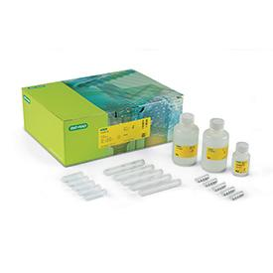
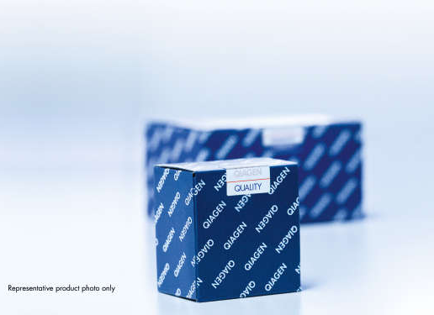
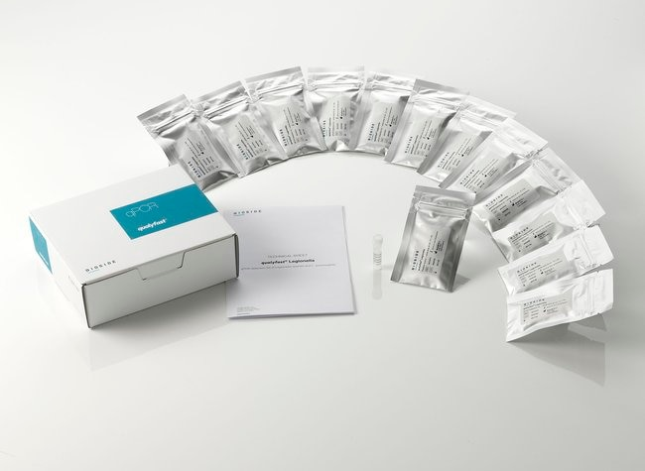
Commercial Extraction Kits Available
Bio Rad - Aquadien™ Bacterial DNA Extraction and Purification Kit
Applicable for both Legionella
& E. Coli Extraction
Suitable for: Bacterial DNA extraction from water samples, Aerosols & Biofilms
QIAGEN- DNeasy PowerWater Kit
Applicable for both Legionella
& E. Coli Extraction
Suitable for: Bacterial DNA extraction from water samples only
Thermo Scientific - qualyfast ® DNA Extraction kit I / II
Applicable for both Legionella
& E. Coli Extraction
Suitable for: Bacterial DNA extraction from Clear/dirty water samples and sediments
Notes:
https://www.bio-rad.com/en-sg/sku/3578121-aquadien-bacterial-dna-extraction-purification-kit?ID=3578121
https://www.qiagen.com/us/products/discovery-and-translational-research/dna-rna-purification/dna-purification/microbial-dna/dneasy-powerwater-kit/
https://www.thermofisher.com/order/catalog/product/D211001

