Slide 1

Specific Requirements for Environmental Testing Laboratories
Notes:
Lab that offers similar tests, ISO17025 (SINGLAS) & CDC ELITE Certified.
https://www.qlaboratories.com/legionella-testing-services/#:~:text=What%20is%20the%20CDC%20ELITE,a%20set%20of%20standardized%20samples.

Slide 2
Scope
The scope of the Environmental Testing field covers various environmental media, such as air, water/wastewater and solid/semisolid hazardous wastes.
SAC-SINGLAS will accredit environmental testing laboratories on an analyte specific basis.

Slide 3
Sampling
Procedure
Ensure analyte originally present does not degrade or be contaminated
Sample Container
Container of appropriate material shall be used and cleaned by specified procedures
Water Sampling (not within control of lab)
*CDC Recommends wide-mouth screw cap polypropylene plastic bottle
Clients shall be instructed
with procedures for taking representative or grab samples
on the correct manner of selecting and cleaning suitable containers
Notes:
Action Items: Guidelines Sampling instructions, Sampling containers → Do we provide ? Or any as long as its sterile
Written according to CDC Guidelines & SG Cooling tower sampling

Slide 4
Reagents & Culture Media
Proper storage of reagents ( according to manufacturer ) & appropriate grade of materials shall be used
Reagent containers shall be labelled with : Reagent name, Date of receipt, Strength, solvent, safety precautions and expiry
Person responsible of preparation of reagents should be identifiable either from label or records
Written procedures for the preparation of reagent solutions and culture media, including records of preparation shall be maintained for later reference. (i.e details like volume, concentration)
Hazardous substance: Under national regulations, should be kept separately from other reagents (locked)
When preparing own media, chemicals used shall be verified to be of appropriate quality concentration. (include details like culture media, medium name, batch number, amount prepared, pH before and after autoclaving, autoclave time and pressure.)
Have procedures for verifying suitability of culture media used. Positive and negative controls shall be applied simultaneously together with material to be tested
Reagents
and Culture media
Notes:
Action items:
1. Document when reagents are made.
Eg. Elysis will be made everytime its needed.
But Elution buffer is not, so after we do testing to see how long its effective, we need to record everytime its made.
2. Procedures on reagent preparation ( eg. ELUTION BUFFER ) -> Need SOP ? Or just a table in the documentation is enough ?

Slide 5
Reference Materials
Certified Reference Materials
Reference material, accompanied by documentation (e.g. COA) issued by an authoritative body and providing one or more specified property values with associated uncertainties and traceabilities, using valid procedures.
Reference Microorganisms
Working stocks cannot be sub-cultured to replace reference stocks. Records of sub-culturing shall be kept.
The laboratory shall hold reference cultures of microorganisms, where appropriate, from a recognised national/international collection to demonstrate traceability. (eg. ATCC)
Reference cultures may be sub-cultured preferably once, no more than 5x from original. Reference stocks to be used to prepare working stocks for routine work ( cannot be re-frozen/re-used once thawed)

Slide 6
Validation of Methods
Carried out by analyzing reference standards of known concentration, both in isolation and in form of spiked samples, and determining the recovery through each stage of the procedure (extraction, conc. of extract & clean up of the extract)
Method Validation
Detection limits, linearity and reproducibility of analysis shall be evaluated on spiked material containing standards covering the expected concentration range.
Replicated analyses shall be carried to ascertain the repeatability of analysis. Inclusion of a control sample in subsequent analyses will serve to check for deviations from the established method.
Method validation also includes - analysing the same sample material by different methods* and comparing the recovery of known amounts of reference standard.
Notes:
For water samples, hard to determine the concentration unless send to Eurofin.

Slide 7
Recoveries
Recoveries
A record must be kept of spiked sample preparation and should contain all relevant particulars such as the name of the person preparing the spiked materials, date of preparation, identification of the spiking standard solution, concentration of the analyte contained in the spike, a batch or identification number, and a discard date.
Carry out the analysis procedure on unspiked samples and spiked samples with known concentration of analyte. Ensure spiked bulk material is homogenous and that sufficient replicate analysis is done to determine the percentage relative standard deviation for each analyte present.
Notes:
Spiked samples work for E. Coli. Extraction. Legionella?
Need to document how to discard ?

Slide 8
Cross Contamination
Able to demonstrate that the accommodation cannot lead to contamination of sample/sample extracts.
Separate work areas shall be available for the following operations
  Purification of reagents
  Adequate and appropriate storage facilities must be available for
    Storage of sample before, during and following analysis
    Storage of materials used in the course of analysis
    Safe storage of hazardous and non-hazardous waste.
    Decontamination of persons and PPE.
Washing-up procedures shall be rigorous enough to ensure no carry-over of residues.
Reference standards, standard solutions and spiked samples shall be stored in a dedicated refrigerator away from samples for analysis
Notes:
Action items:
Where are we gonna make the lysis buffer and elution buffer, addition of PMA (DARK ROOM) – Need Laboratory Workflow
Storage of samples :
WATER SAMPLES, SPIKED SAMPLES & SAMPLES for analysis should be separate. (dedicated fridge) ( Keep for a week or ? ) – Retained samples are required
Disposal of waste water → Su Yan suggested filter then pour bleach on filter paper .
PPE: disposable mask sufficient ? N95 ?

Slide 9
Laboratory Personnel
Qualifications
Specialized area
Senior Technical Position : Tertiary qualifications in relevant scientific field or relevant working experience ; at least one year lab experience or in-house training
eg. Legionella: preferably have formalised internal/external training in the area. A scheduled quality control check shall be formalized to ensure that faculty for correct evaluation of result is maintained for all technicians
eg. CDC’s ELITE Programme for Legionella Testing
Technical Manager : Tertiary qualifications from recognized institution in environment/science discipline & at least 3 years lab experience
https://www.cdc.gov/legionella/labs/elite.html

Slide 10
CDC’s ELITE Programme for Legionella Testing
Centers for Disease Control Environmental Legionella Isolation Techniques Evaluation (ELITE).
Laboratories can test their Legionella isolation techniques against standardized samples.
Participating labs receive a panel of lyophilized test samples twice each year from the Wisconsin State Laboratory of Hygiene.
Some of the test samples are Legionella positive and some are Legionella negative. The test samples may also include other organisms commonly found in water.
Report results and labs that correctly identify Legionella in 2 consecutive panels receive documentation for passing the proficiency test. (spread-plate culture method)
Notes:
Action Items: Not sure if we can do it internally like RSPO. Or would we need external proficiency testing.
- SENDS ( USD $168 )
https://wwwn.cdc.gov/Elite/Public/FAQ.aspx

Slide 11
Proficiency Testing
Proficiency Testing
Labs accredited for the analysis of Legionella testing should participate in a recognized programme at least once a year. The testing method used in the proficiency programme should be that is routinely used for analysis of samples.
Samples tested by two or more analysts
Participation should be recorded and where poor results are obtained, details of corrective action should be taken.
Examples: LGC Standards
Notes:
https://wwwn.cdc.gov/elite/public/elitehome.aspx
https://www.sigmaaldrich.com/SG/en/product/sial/mic004
https://www.lgcstandards.com/SG/en/418-Legionella-species-Environmental-waters/p/PT-WT-418
https://lgcstandards-assets.s3.eu-west-1.amazonaws.com/MediaGallery/PT-Scheme-Documents/English/QWAS/QWAS_Scheme_Description_GB.pdf
^(inclusive of e. coli)

Slide 12
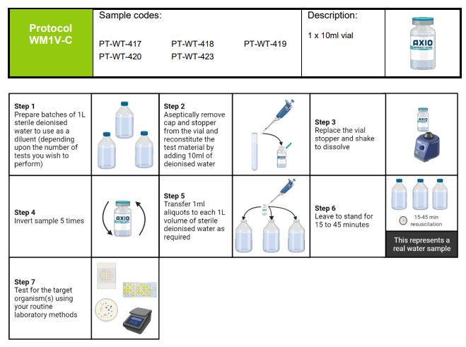
LGC Proficiency Test
Sample Code
PT-WT-417 : Legionella Pneumophila in Industrial Water
PT-WT-418 : Legionella Species in Industrial Water
Notes:
https://s3-eu-west-1.amazonaws.com/lgcstandards-assets/MediaGallery/PT-Scheme-Documents/English/QWAS/QWAS+instruction+sheet.pdf

Slide 13

LGC Proficiency Test
Notes:
https://lgcstandards-assets.s3.eu-west-1.amazonaws.com/MediaGallery/PT-Scheme-Documents/English/QWAS/LGC_AXIO_QWAS_Web+Application+Form+2023.pdf

Slide 14
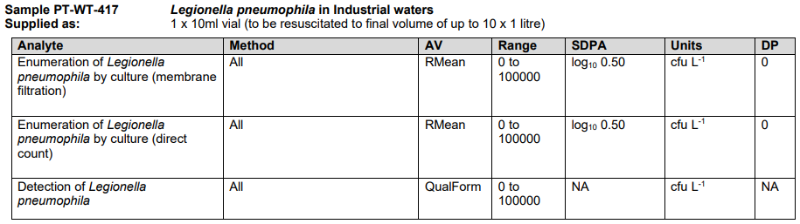
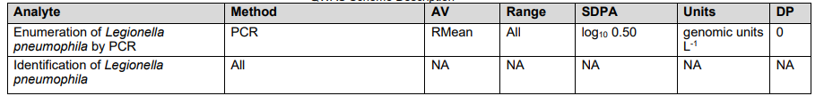
LGC Proficiency Test
Legend:
AV: Assigned Value
SDPA: Standard Deviation
for Proficiency Assessment
DP: Decimal Point
Notes:
https://www.lgcstandards.com/SG/en/417-Legionella-pneumophila-Environmental-waters/p/PT-WT-417

Slide 15
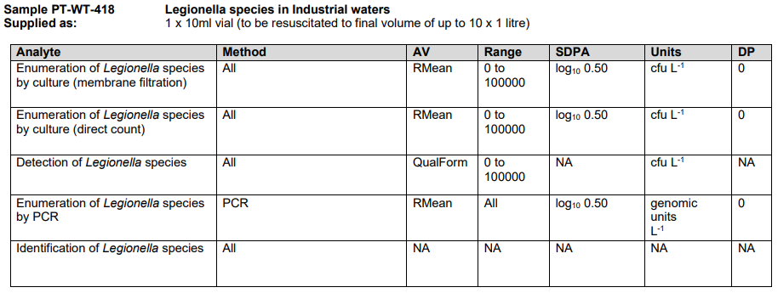
LGC Proficiency Test
Notes:
https://www.lgcstandards.com/SG/en/418-Legionella-species-Environmental-waters/p/PT-WT-418

Slide 16
Quality
Each batch to include one QC Sample, Reference Matrix Blank (Water)
Quality Control
Quality Assurance
QC Samples must either be a homogenous sample of the same matrix analyzed repeatedly in each batch or duplicate analyses of one or more samples in each batch.
Operate a formal quality assurance programme. Minimally, include initial demonstration of laboratory capability, analysis of spiked samples spiked with labelled compounds to evaluate and document data quality, and analysis of standards and of solvent and/or sample matrix blanks as tests of continuing performance.
The following analytical characteristics must be established by means of the procedures described in the test method:-
a) Initial precision and accuracy;
b) Method performance on the sample matrix, by analysis of spiked recovery samples;
c) Recovery of labelled compounds in the labelled compound spiking standard;
d) Method blanks, by analysis of reference matrix blanks.

Slide 17
Action Items
No. | Documents to Prepare
1 | SOP for Sampling
2 | Records of Reagent Preparation (Person, Date of Prep, Expiry ..)
3 | SOP for Reagent Preparation (E-Lysis and A1 Buffer)
4 | Culture Media Preparation (Volume, Autoclave details .. )
5 | Certified Reference Materials (COA for reagents)
6 | Validation Report(s)
7 | Records of Spiked Sample Preparation (Person, Date, Discard Date ..)
8 | SOP for spiking samples
9 | Laboratory Workflow
10 | Participate in Proficiency Testing Programme
11 | Retaining Samples
12
Notes:
Validation Reports: We need to know the concentration of the samples we are extracting.

